Slide 1

by team jiminy cricket

Slide 2
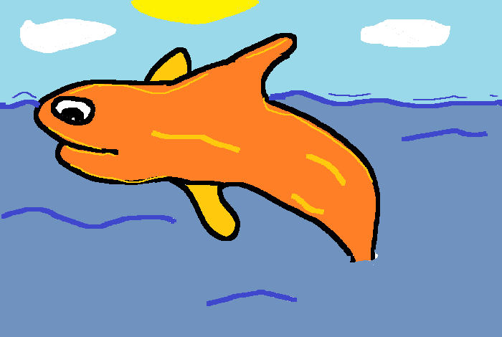



jiminy cricket is made of
Charles Madere
Joseph Gautier
Geonathan Sena
Jarrad Pinestraw

Slide 3

what is We Paint?
A 100% in web browser game very similar to Pictionary
One user will have a certain amount of time to draw a picture of an item of a chosen topic while his Facebook friends compete over chat to be the first to guess the name of what he’s working on in order to score points
On correct answer the next user in the group will have a turn to draw

Slide 4







technology we’re using
JSON
CSS
NetSal

Slide 5



browser support
HTML5 features are still in a somewhat experimental stage
We are going to focus primarily on Google Chrome, Mozilla Firefox, and Internet
Explorer 9

Slide 6
still to do (there’s plenty!)
Saving / exporting the drawn images
Games!!
Basic sounds during certain events
Chat
Several sessions at once
More Facebook integration

Slide 7










about chat
Originally we were going to try to implement native Facebook chat
Instead we’ve now decided to create our own web-based group chat app using HTML5
Will still use the Facebook API for other bits
emoticons!

Slide 8

about
The Facebook API’s consists of both PHP and JavaScript code
In order to gather Facebook details our application must first ask for permissions from the user
  The only permissions we will need are the user’s name and the name of his friends
We can then search through the user’s friends and invite particular ones to the game

Slide 9
questions before
the prototype?

Slide 10

get ready to paint!
http://wepaint.us/

